Slide 1
Weighing in on Neutron Stars
Varun Bhalerao
California Institute of Technology
Collaborators: F. Harrison, S. Kulkarni, Marten van Kerkwijk, and others

Slide 2
Weighing in on Neutron Stars
Why?
How?
What?
Classes of objects
Examples
Upcoming results
Varun Bhalerao

Slide 4
Fundamental questions:
Equation of state of densest matter
The physics of core collapse
Relation between initial mass and final mass (Neutron star)
Notes:
Neutron stars: end points of stellar evolution
can tell us about funda quest

Slide 5
Maximum Neutron Star mass
PSR J1614-2230
PSR J1903+0327
Lattimer and Prakash, 2007
Notes:
PSR J1903+0327 = 1.67 +- 0.01 Msun (NS + MS); PSR J1614-2230 = 1.97 +- 0.04 Msun (NS + WD)
talk about radii !
Lattimer & Prakhash, Physics Reports, 442, Issue 1-6, pp. 109-165

Slide 6
Binaries
Neutron star + Neutron star
Neutron star + White Dwarf
Low Mass X-ray Binaries
High Mass X-ray Binaries
PSR J2230-1614
PSR J1719-1438
[PMH2004] 47

Slide 7
Measuring masses: Binaries
Binary orbit is characterized by 7 orbital elements:
Period (P)
Semi-major axis (a)
Angle of inclination (i)
Eccentricity (e)
Mean anomaly at epoch (M₀)
Longitude of ascending node (Ω₀)
Argument of periapsis (ω₀)

Slide 8
Measuring NS masses
X-ray / Radio timing observations yield
Period (P)
Eccentricity (e)
(a sin i )
Mass function of companion star (f₁)
Eclipsing systems: unambiguous mass measurement
Notes:
Armed with these equations, we can go and measure masses of neutron stars, and look at the mass distributions.

Slide 9
Mass distribution
NS+NS binaries:
1.35 ± 0.13 M
NS+WD binaries:
1.50 ± 0.25 M
Kiziltan, Kottas & Thorsett, 2010
Notes:
and what we see, is this

Slide 10
How? What?
Observations & Results

Slide 11
NS – NS binaries

Slide 12
NS – NS binaries
Formed in quick succession
Relatively “pristine” neutron stars
Measure inclination and masses from relativistic effects:
Advance of periastron
Transverse doppler shift + Gravitational redshift
Orbital decay by gravitational waves

Slide 13
NS – NS binaries
Source: www.stellarcollapse.org
Notes:
Dotted line: mean, Dashed line: weighted mean

Slide 14
NS – WD binaries

Slide 15
NS – WD binaries
Birth: Massive star + low / intermediate mass star
Massive star → NS
Binary orbit should survive
Companion loses mass in evolution
Mass transfer may spin up NS
Millisecond pulsar

Slide 16
Spin-up of millisecond pulsars
Bhalerao & Kulkarni, ApJ, 2011; with data from ATNF pulsar database

Slide 17
NS-WD systems
Source: www.stellarcollapse.org
Notes:
Dotted line: mean, Dashed line: weighted mean

Slide 18
PSR 1614-2230
A 2 M neutron star

Slide 19
Discovery
Counterpart to EGRET source
Hessels et al., 2005
3.15 ms period
Early data indicated companion > 0.4 M
Follow-up pulsar timing at Green Bank Telescope
Demorest et al., 2010

Slide 20
Measuring the mass: Shapiro delay
Timing residuals (μs)
Neutron star mass:
1.97 ± 0.04 M
Companion mass:
0.500 ± 0.006 M
Spin period:
3.151 ms
Period derivative:
9.6216(9)×10⁻²¹ s s⁻¹
Orbital period:
8.687 d
Non-relativistic fit
Relativistic fit
Demorest et. al, Nature, 2010

Slide 21
Implications
Limits on maximum central density and pressure
Same equation of state applies to all neutron stars!
“Soft” equations of state ruled out
No exotic matter (hyperons, kaon condensates) in neutron star cores
Ref: “What a Two Solar Mass Neutron Star Really Means”, Lattimer et al., arXiv:1012.3208

Slide 22
Maximum Neutron Star mass
PSR J1614-2230
Lattimer and Prakash, 2007
Notes:
PSR J1903+0327 = 1.67 +- 0.01 Msun (NS + MS)
PSR J1614-2230 = 1.97 +- 0.04 Msun (NS + WD)
Radii can change a bit if accreting
Lattimer & Prakhash, Physics Reports, 442, Issue 1-6, pp. 109-165

Slide 23
Optical follow-up
R band
g band
Bhalerao & Kulkarni, ApJ, 2011

Slide 24
Age and Evolution
WD cooling age: 2.2 Gyr (Chabrier et al., ApJ, 2000)
Birth spin period: 2.75 ms – 3.15 ms
Slower than the standard spin up model !
Bhalerao & Kulkarni, ApJ, 2011

Slide 25
Low/Intermediate Mass X-ray Binaries

Slide 26
Low/Intermediate mass Binaries
Low mass star + NS: typically mass transfer in system
Seen in X-rays, hence LMXB
Intermediate mass systems: no mass transfer
no “IMXB”s
Not all evolve into NS + WD systems: Ultra-Compact systems may form “Black Widow Pulsars”

Slide 27
PSR J1719-1438: A pulsar with a “planet”
Bailes, M; Bates, S D; Bhalerao, V; Bhat, N D R; Burgay, M; Amico, N D; Johnston, S; Keith, M J; Kramer, M; Kulkarni, S R; Levin, L; Lyne, A G; Milia, S; Possenti, A; Spitler, L; Stappers, B; Straten, W Van
Science, 2011

Slide 28
PSR J1719-1438: Characteristics
Spin period: 5.7 ms
Period derivative:
7.1(7)×10⁻²¹ s s⁻¹
Magnetic field:
< 2×10⁸ G
Characteristic age: > 12.5 Gyr
Orbital period: 2.2 h
Projected semi-major axis (a_{p} sin i) = 1.82 ms
Bailes et. al, Science, 2011

Slide 29
Companion mass
Bailes et. al, Science, 2011
Notes:
& &f(m_c) = \frac{4\pi}{G} \frac{(a_p \sin i)^3}{P_b^2} \\
& & = \frac{(m_c \sin i)^3}{((m_c + m_p)^2} = 7.85(1) \times 10^{-10} {\rm M}_\odot
m_c > 1.15 \times 10^{-3}{\rm\,M}_\odot
\rho_c > 23{\rm\,g\,cm}^{-3}

Slide 30
Nature of the Companion
Bailes et. al, Science, 2011

Slide 31
Nature of the Companion
Bailes et. al, Science, 2011
Notes:
& &f(m_c) = \frac{4\pi}{G} \frac{(a_p \sin i)^3}{P_b^2} \\
& & = \frac{(m_c \sin i)^3}{((m_c + m_p)^2} = 7.85(1) \times 10^{-10} {\rm M}_\odot
m_c > 1.15 \times 10^{-3}{\rm\,M}_\odot
\rho_c > 23{\rm\,g\,cm}^{-3}

Slide 32
Optical search
Case 1:
CO / He WD
T = 4500 K
Expect 26 < m_{R} < 28
Case 2:
Compact star
Optical non-detection consistent with Case 1
m_{R} > 25.4
m_{g} > 24.1
m_{I} > 22.5
Bailes et. al, Science, 2011

Slide 33
Evolution of NS+WD systems
Some LMXBs form Ultra-Compact systems, driven by gravitational radiation losses
Fate determined by the inverse Mass-Radius relationship of WDs
High mass WD: compact, Roche overflow occurs very late, companion destroyed, leaves solitary millisecond pulsar
Low mass WD: Roche overflow when orbit is few hours, creates Black widow systems
Notes:
& &f(m_c) = \frac{4\pi}{G} \frac{(a_p \sin i)^3}{P_b^2} \\
& & = \frac{(m_c \sin i)^3}{((m_c + m_p)^2} = 7.85(1) \times 10^{-10} {\rm M}_\odot
m_c > 1.15 \times 10^{-3}{\rm\,M}_\odot
\rho_c > 23{\rm\,g\,cm}^{-3}

Slide 34
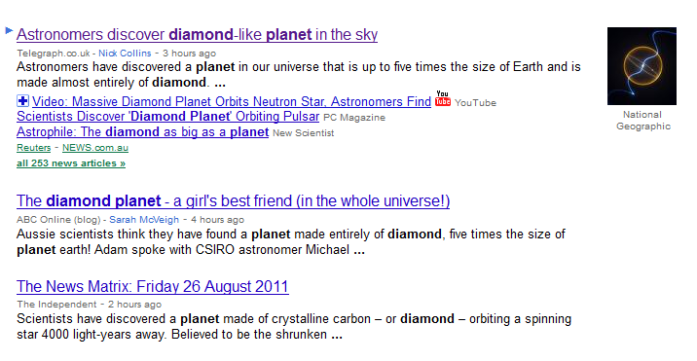
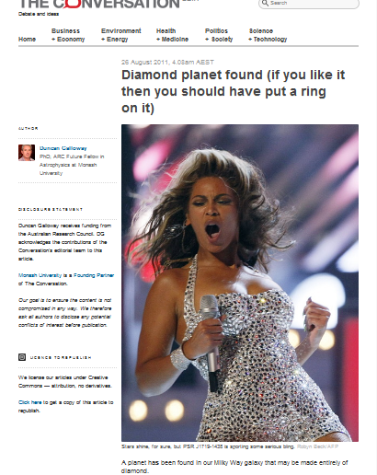

Slide 35
High Mass X-ray Binaries

Slide 36
Wind-fed accretion

Slide 37
Roche lobe overflow

Slide 38
Be X-ray Binaries
dM/dt
time

Slide 39
High Mass X-ray Binaries
EXO 1722-363
Adapted from Rawls et. al, ApJ, 2011

Slide 40
A systematic Radial Velocity survey
18 High Mass X-ray binaries
5 eclipsing systems
13 with known periods + confirmed neutron stars
Instruments:
NIRSPEC: IR Echelle spectrograph at 10 m Keck II telescope (H band)
DBSP: Optical spectrograph at 5 m Hale telescope at Palomar

Slide 41
A systematic Radial Velocity survey
Measure mass for eclipsing systems, M sin i for others
High quality spectra: typical SNR > 50
Expect 10% – 20% accuracy in M sin i
Robust statistics as a class of objects

Slide 42
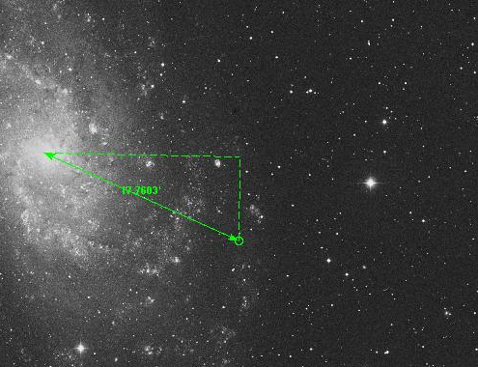
[PMH 2004] 47
Discovery: Pietsch et al., 2010
Eclipsing High Mass X-ray Binary
Period = 1.73 days
X-ray spectrum suggests NS

Slide 43
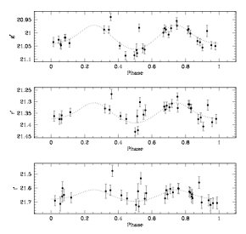
[PMH 2004] 47
Optical counterpart shows ellipsoidal modulation

Slide 44
[PMH 2004] 47
Spectral type: B1

Slide 45
[PMH 2004] 47

Slide 46
[PMH 2004] 47

Slide 47
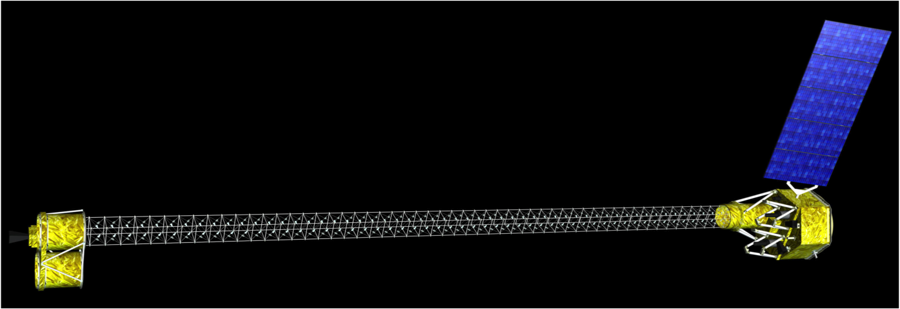
New HMXBs: NuSTAR
Focusing Hard X-ray telescope
Launch: Feb 2012
Compared to
current state-of-the-art:
10x angular resolution , 100x sensitivity
Galactic plane survey: expect dozens of new HMXBs

Slide 48
Astrosat
X-ray timing
X-ray binaries
Thermonuclear bursts

Slide 49
Future developments
Our survey of neutron stars in HMXBs
X-ray studies with NuSTAR:
Photospheric expansion bursts
Quasi-periodic oscillations
More pulsar discoveries and characterizations
Pulsar Gravitational Wave projects

Slide 50
Discussion

