Slide 1
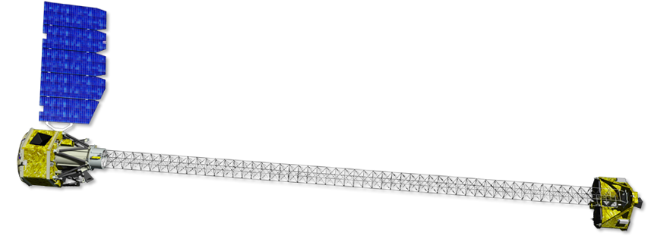
The Nuclear Spectroscopic Telescope Array
NuSTAR
Varun Bhalerao on behalf of the NuSTAR team

Slide 2
What is NuSTAR?
The Nuclear Spectroscopic Telescope Array is a NASA small explorer mission, the first focusing hard X-ray space telescope. It will address select science goals in a two year baseline mission, followed by a possible guest investigator program.
Notes:
Here is a two-sentence summary of my entire talk. (highlight). The main points are that NuSTAR is a SMEX rather than a part of the great observatories program. It is the first time that a focusing hard X-ray satellite is being flown. The primary mission is a PI-led survey program, which will undertake observations identified by the science team.

Slide 3
Why hard X-rays?
Innovations in NuSTAR
Science goals
Notes:
I will first discuss why hard x-ray astronomy is important. Then, I will talk about the challenges and how they have been overcome in Nustar. Finally, I will discuss some of the science goals of nustar.

Slide 4
Why hard X-rays?
Innovations in NuSTAR
Science goals
Notes:
So what is it that we can learn from Hard X-rays that we cannot learn from Chandra and XMM ?

Slide 5
Hard X-rays
Gamma
rays
Optical
IR
X-rays
Radio
Fermi
NuSTAR
6 – 80 keV
Keck
GMRT
Temperature
K
Energy
eV
Frequency
Hz
Wavelength
cm
Notes:
The “Hard X-ray band” is rather loosely defined, and is often based on what instrument you are talking about. Here, I define the Hard X-ray band as 6 or 10 keV to 80 keV, or about 0.15A to 2A
Fermi: > 150 keV on 2 GBM Bismuth Germanate scintillators, but most are NaI with 8 keV to 1 MeV

Slide 6
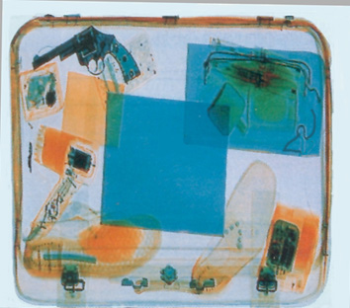
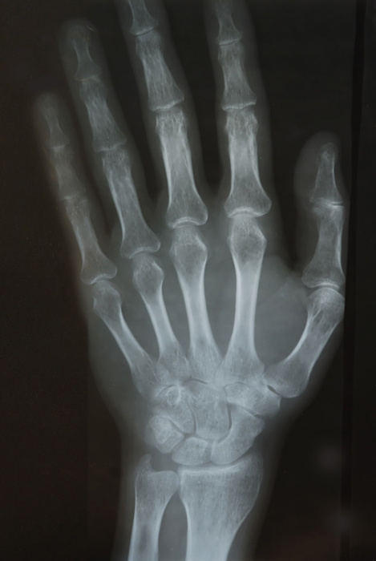
Hard X-rays
Highly penetrating radiation
Notes:
Hard x-rays have higher penetrating power than any lower energy photons. Indeed, X-rays around 30-50 keV are used for medical imaging, airport x-ray scanners etc. At high hydrogen column densities, like areas near the galactic center, soft x-rays can be significantly attenuated. Clearly, to look at highly obscured sources we need to use this energy range. An example is Integral – which discovered several HMXBs which had not seen before.

Slide 7
Hard X-rays: Penetration
Notes:
For example, the spectra of heavily compton thick AGN with column densities > 10^25 cm^-2 peak in the NuSTAR band, making Nustar an ideal instrument to study these. nh 2e21 = av 1

Slide 8
Hard X-rays: Non-thermal emission
Blackbody spectra for few million Kelvin temperatures peak at few keV
In soft X-rays, thermal emission dominates over non-thermal emission
Thermal
Non-thermal
Galaxy cluster A2256 simulation by Molendi (NuSTAR internal memo)
Notes:
Million kelvin blackbodies peak in soft X-rays. If there is any underlying non-thermal component: synchrotron, inverse compton etc, typically it is much smaller in comparison to be seen in this band. (advance). however, when we extend the range to hard X-rays, then such components can be seen, and we can discern more about the nature of the emitter. For example, in galaxy clusters, there is a non-thermal component expected from shocked gas, and NuSTAR data can be used to discern shock properties.

Slide 9
Why hard X-rays?
Innovations in NuSTAR
Science goals

Slide 10
INTEGRAL

Slide 11
Focusing X-rays
Animation courtesy Chandra X-ray Observatory (Youtube)

Slide 12
Focusing Hard X-rays
Lower graze angle: < 0.1º
Multi-layered coatings
130 confocal nested shells
2 telescopes to increase area
Notes:
Focusing X-rays is hard, and focusing hard Xrays is even harder. First, we need shells with even lower graze angles. Then, to have a wide energy range, we have a multi-layered coating: where the thinnest layers are about 20 A – just few atoms thick. Finally, the projected area of each shell is very small, so we use 130 concentric, confocal shells. And to get to higher collecting area, we use 2 identical telescopes.

Slide 13
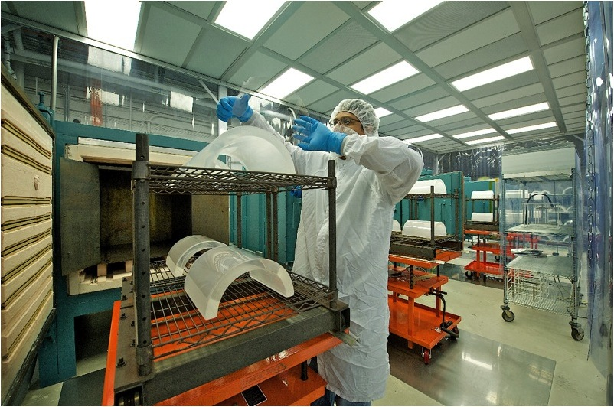
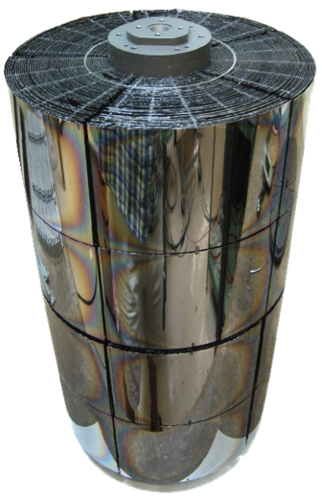
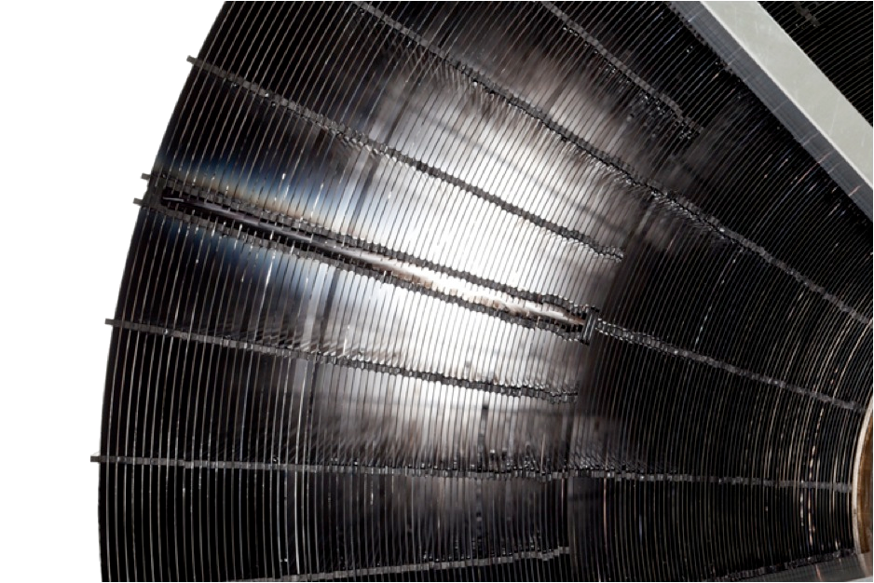
NuSTAR optics
Notes:
Here is how we make the optics: we take glass and put it over quartz mandrels, then heat it in an oven. This bends the glass into shape. Each shell has a slightly different shape, and is made on a different mandrel. Then we apply the multi-layer coating, and assemble the module. (advance) The assembled module looks like this.

Slide 14
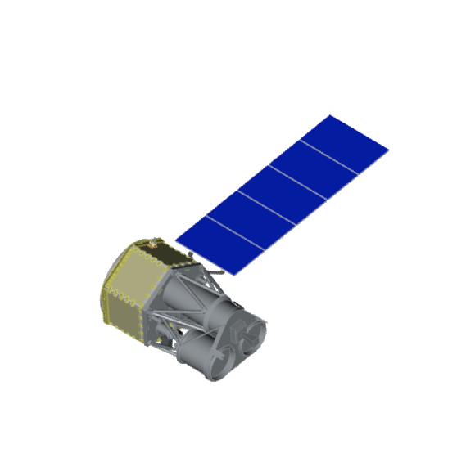
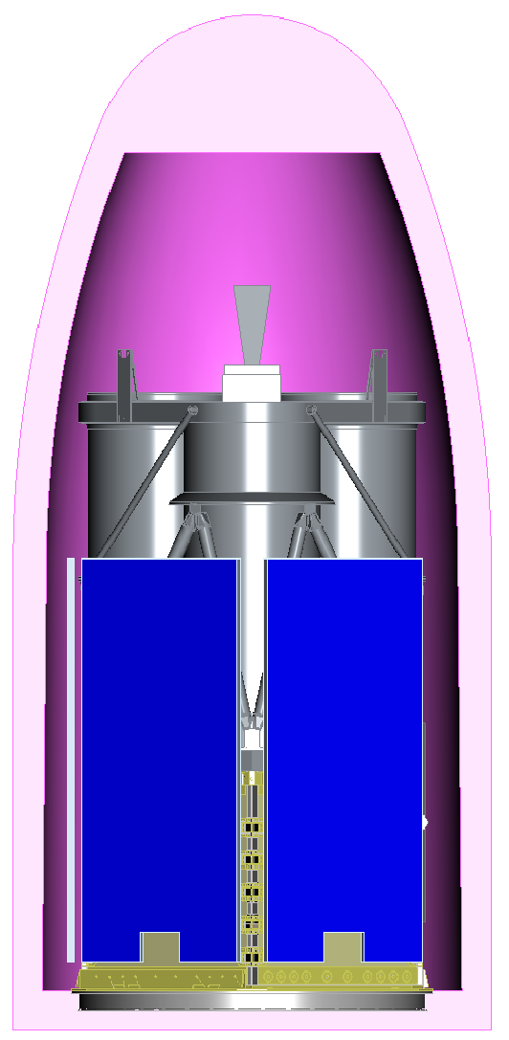
Long focal length
Notes:
Since NuSTAR is a small explorer, the launch configuration has to be compact to fit in a small rocket. To achieve the long focal length, we use a expandable mast which was developed for a aperture synthesis radar space shuttle experiment.

Slide 15
The NuSTAR mast

Slide 16
CdZnTe detectors
Hard X-rays penetrate CCDs: need something else
Focusing optics: need imaging detector
Requirements:
Fine pixel pitch
High Quantum Efficiency
Good energy resolution
Good timing properties

Slide 17
NuSTAR CZT Detectors
32x32 pixels
4 detectors
600μm pitch
12”/pixel
2 mm thick
QE > 95%
Notes:
As a part of the instrument team, I worked on detectors. We developed custom electronics and detectors, building on the legacy of our older balloon mission called HEFT. These detectors currently have the highest EQ ever achieved in a telescope in this band. We have an energy resolution of about 400 eV at 10 keV, and 800 eV at 60 keV. In terms of science, it means we can resolve nuclear decay lines, and measure the velocities of the emitting regions to 1% of c.

Slide 18
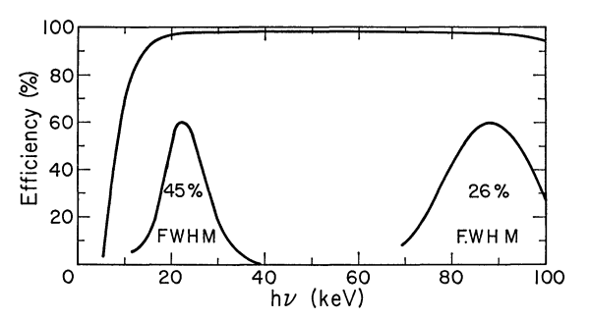
Old: NaI spectra
22 keV:
FWHM= 10 keV
88 keV:
FWHM= 23 keV
Seward and Toor, 1967

Slide 19
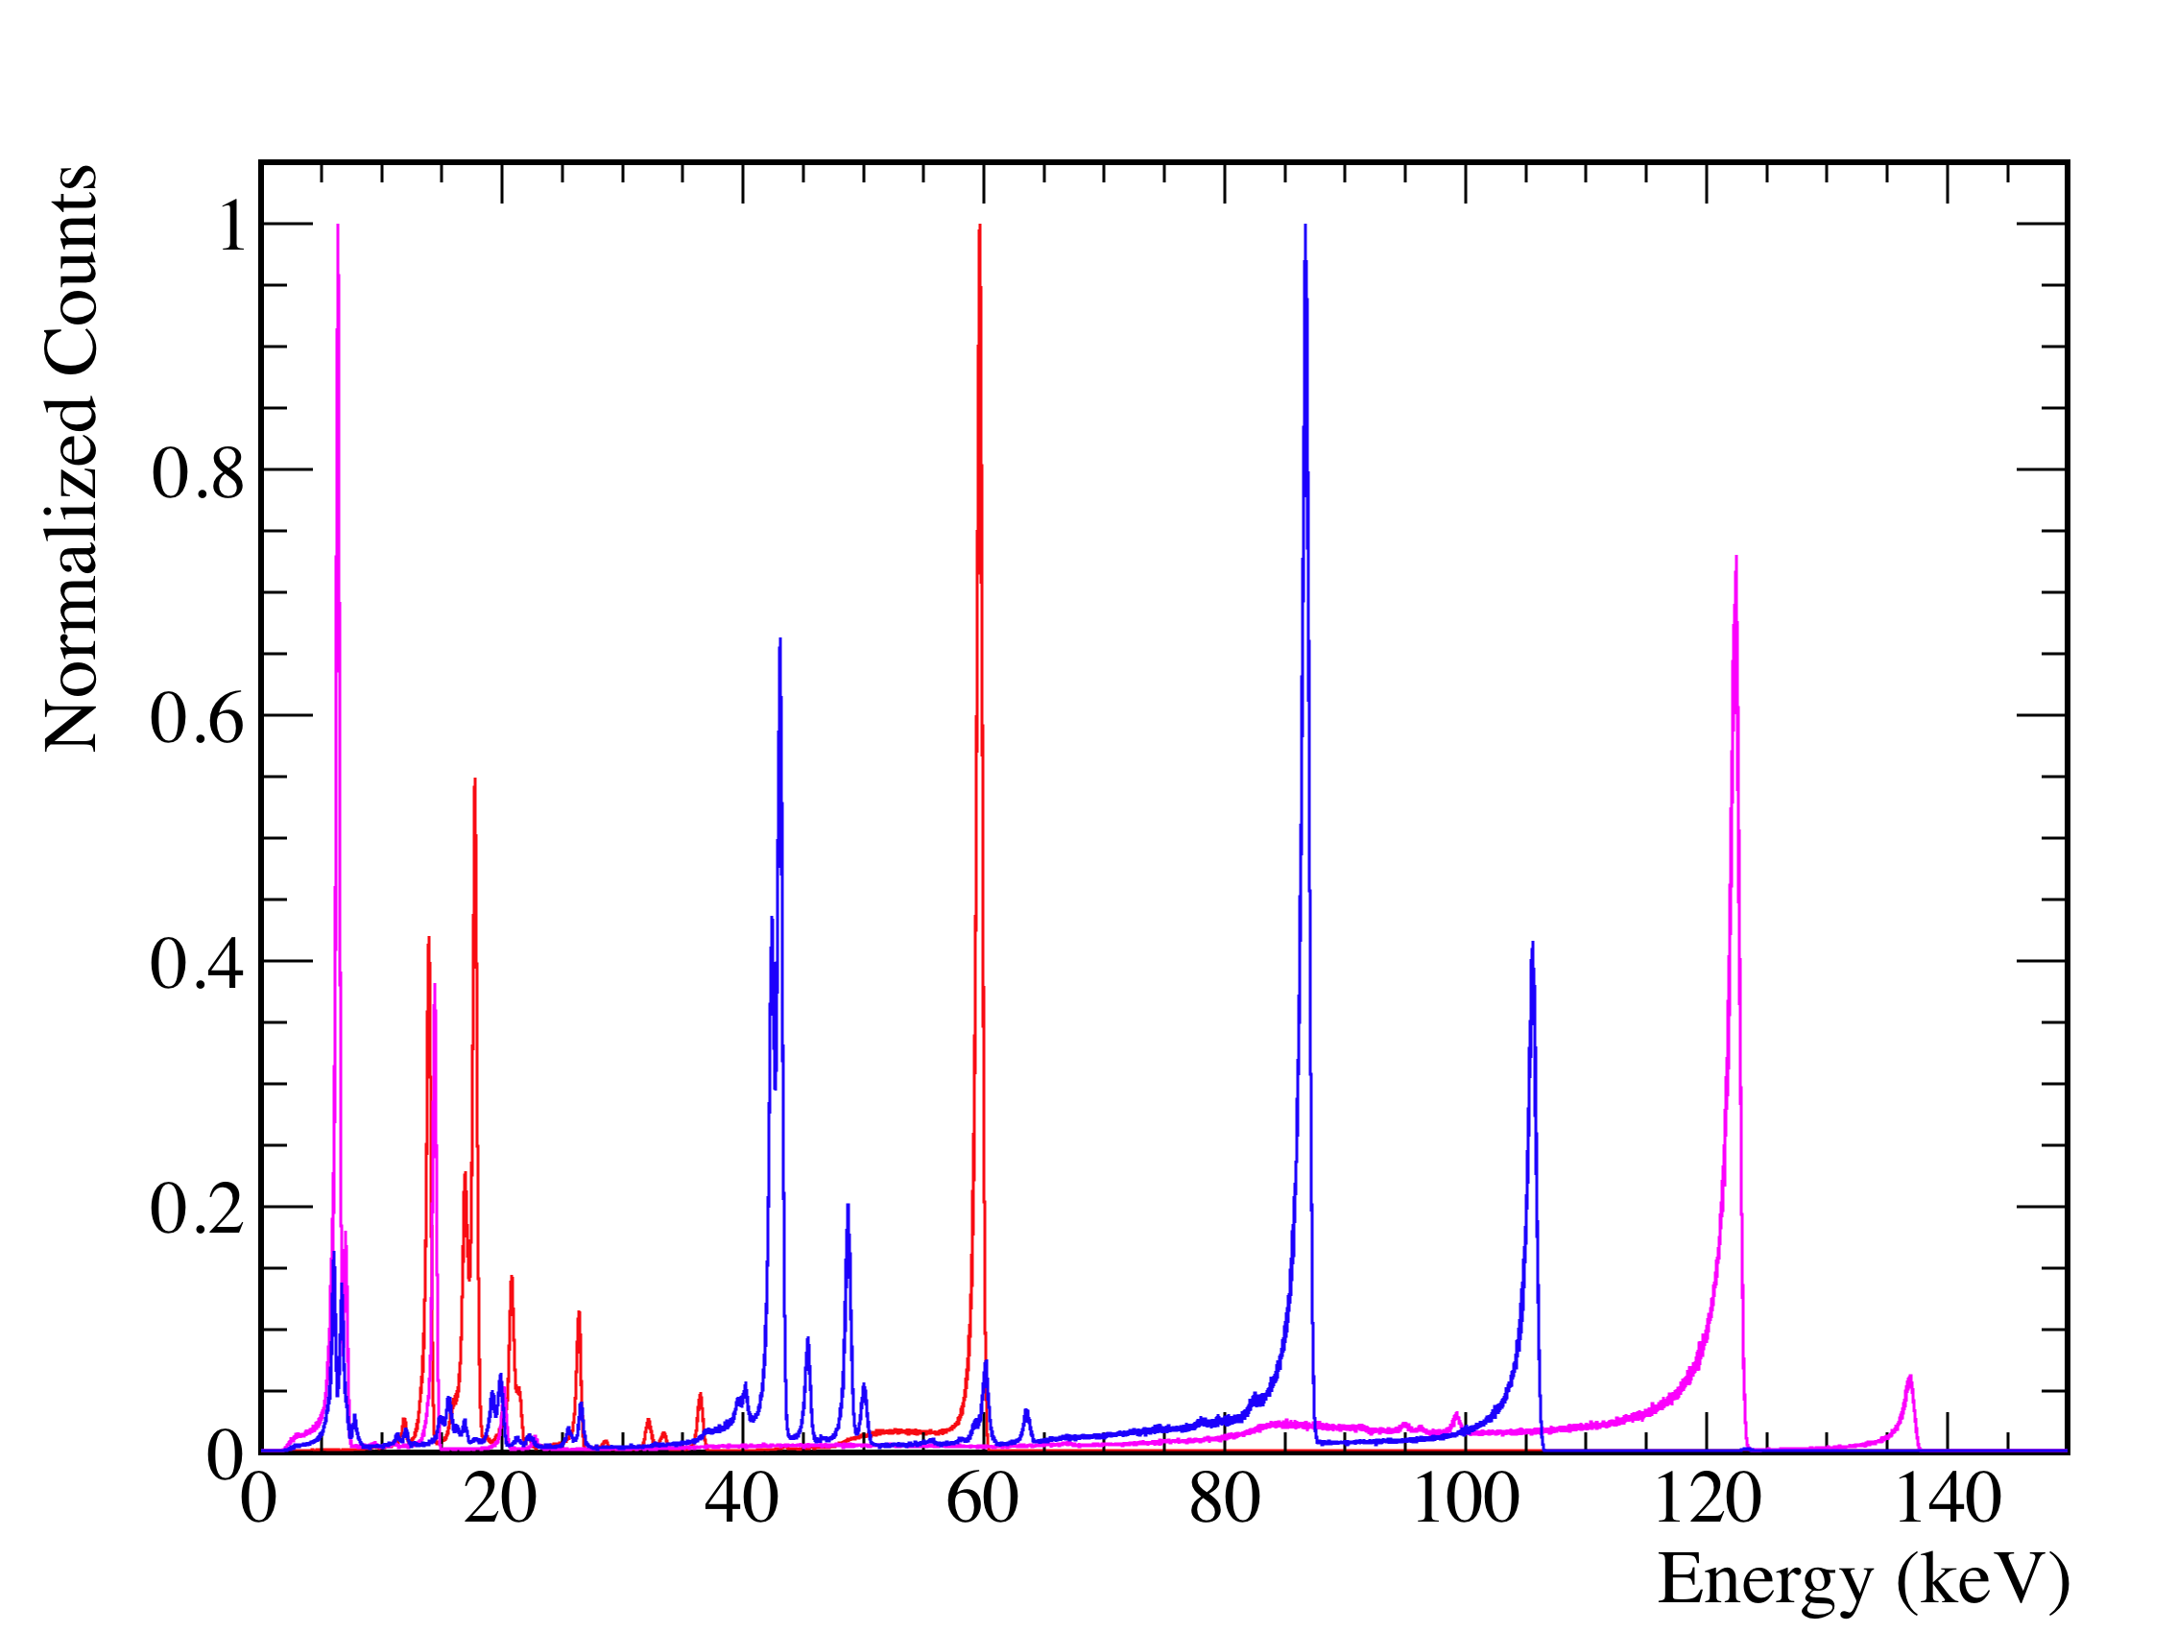
NuSTAR CdZnTe spectra
59.54 keV
⁵⁷Co
¹⁵⁵Eu
²⁴¹Am
86.54 keV
122 keV
0.6 keV FWHM

Slide 20
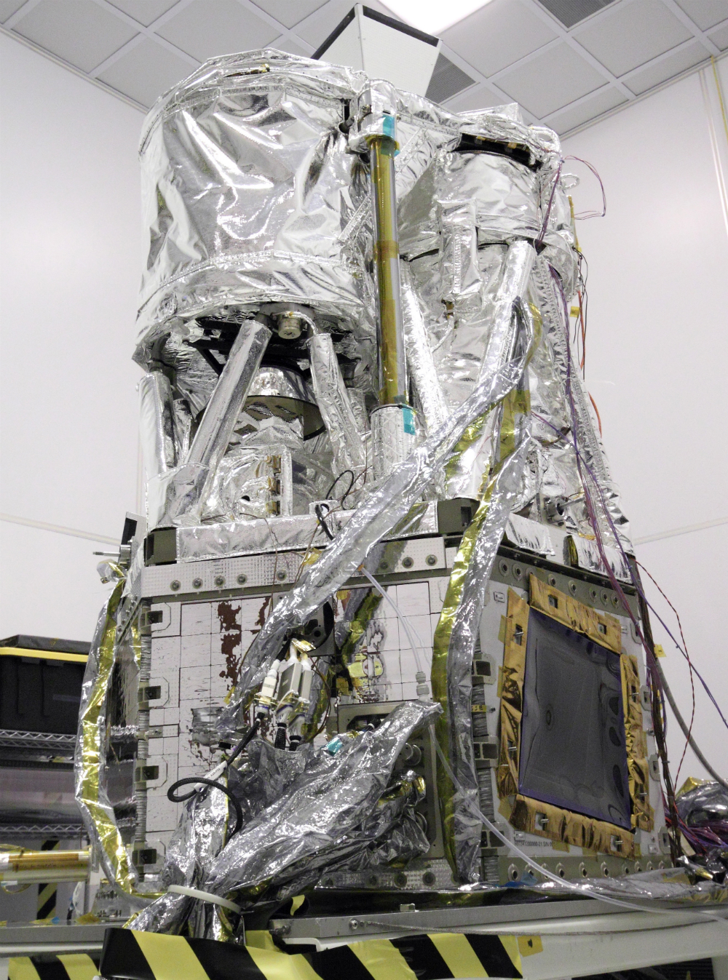
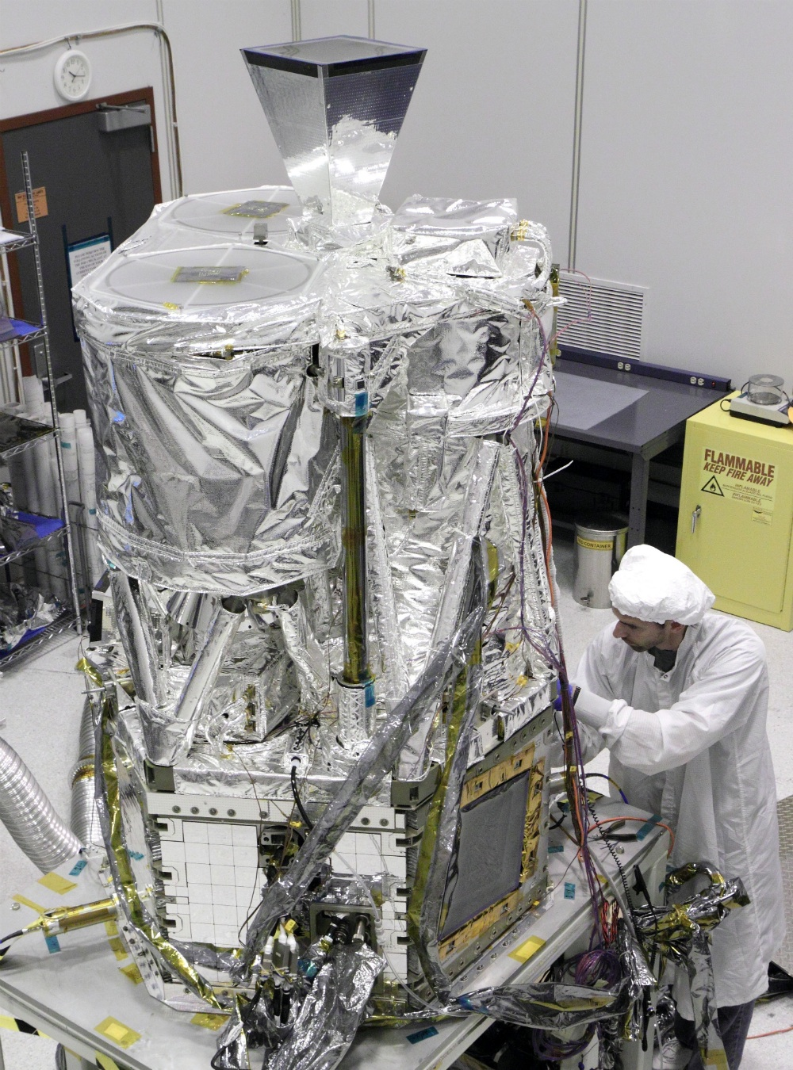

Slide 21
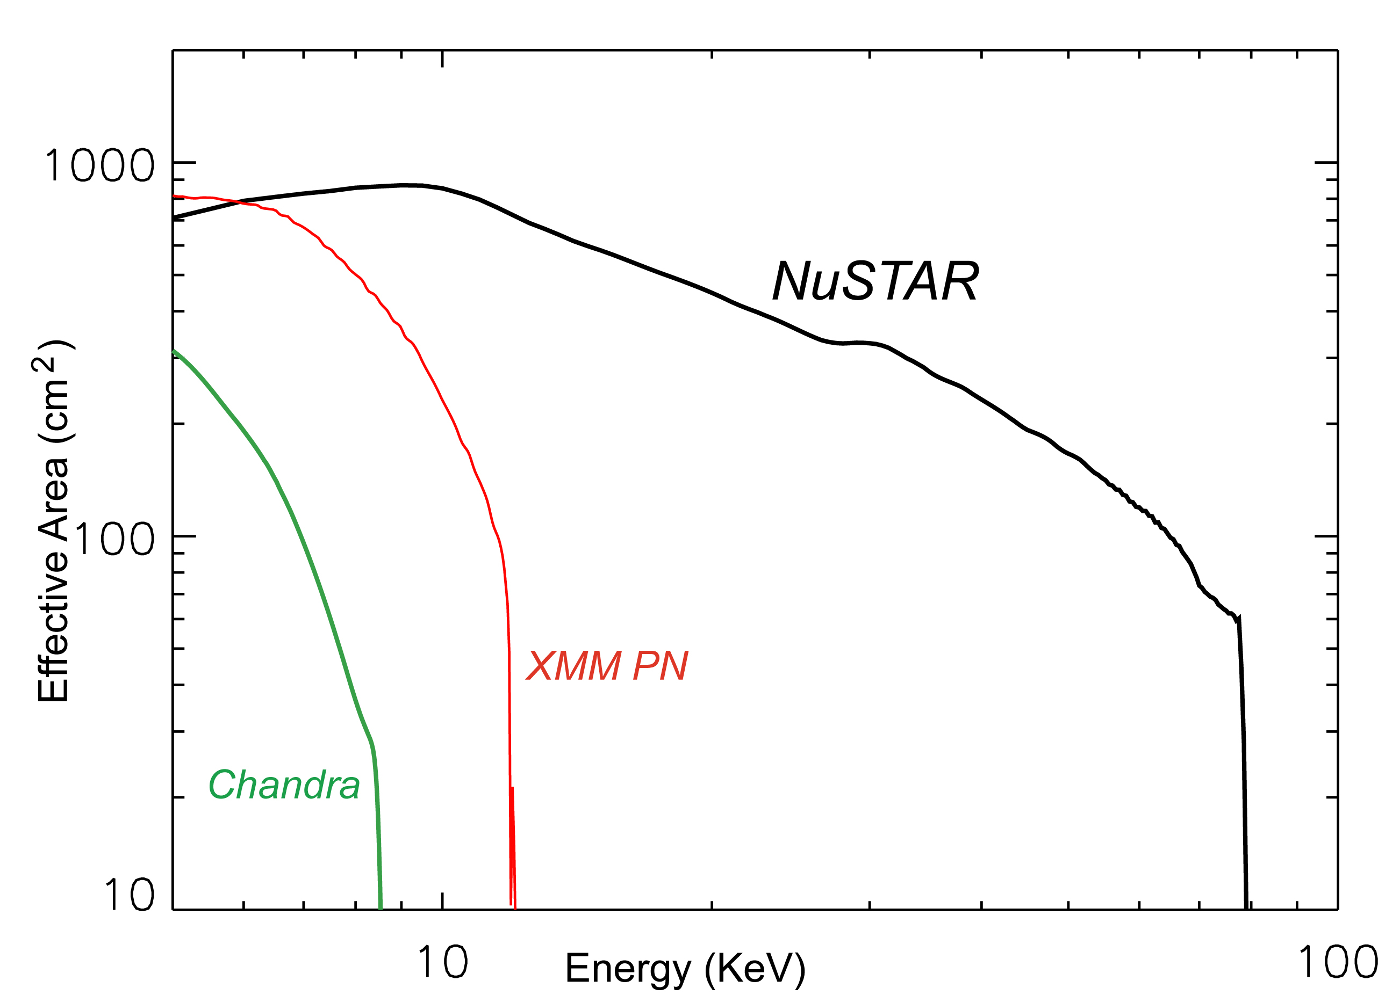
Instrument Specs
Energy range: 5 – 80 keV
Angular resolution:
Half-Power Diameter: 50”
Sharp core of Point Spread Function: FWHM < 10”
Point source positioning accuracy: 1.5”
Field of view: 10’ at 10 keV, 6’ at 68 keV
Sensitivity (1 Ms, 3-sigma):
6 – 10 keV : 2 × 10⁻¹⁵ erg cm⁻² s⁻¹
10 – 30 keV : 1 × 10⁻¹⁴ erg cm⁻² s⁻¹

Slide 22
Comparisons: Extragalactic
Integral IBIS, 20 – 40 keV
2x2 degree, 2 months
NuSTAR Simulation
2x2 degree, 1 Ms (≈12 days)

Slide 23
Why hard X-rays?
Innovations in NuSTAR
Science goals

Slide 24
Science
Primary Objectives:
Cosmic evolution of Supermassive Black Holes
Compact objects in the Galaxy
Physics of supernova explosions
Physics of extreme AGN
Notes:
How are black holes distributed in the cosmos, and how do they affect the formation of galaxies?
How are stellar remnants distributed within the galaxy and near the galactic center?
How do stars explode and forge the elements that form the earth?
What powers the most extreme galactic nuclei?

Slide 25
Science
Galactic survey, SgrA*
Supernova Remnants / Planetary Wind Nebulae
Supernova Ia ToO
Magnetars
X-ray Binaries
Pulsars
Gamma-ray binaries
Flaring protostars
Sun
Extragalactic surveys
AGN physics
Ultra-Luminous Infra-Red Galaxies (ULIRGs)
Compton-thick AGN
Starburst galaxies
Galaxy clusters
Blazars
Radio galaxies
Ultra-Luminous X-ray Sources

Slide 26
Galactic Plane Survey, Sgr A*
Science goals

Slide 27
Aims
Populations in Galactic Center, Spiral arms, and Galactic Bulge
Reflection nebulae as a record of historical X-ray activity in the GC region
Sgr A*: X-ray flares and emission mechanisms
Galactic Ridge X-ray emission
Finding compact objects in young massive clusters
Small Magellanic Cloud: Populations in regions with high star formation rates

Slide 28
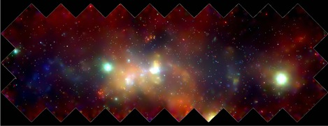
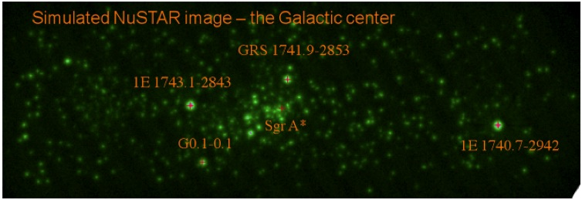
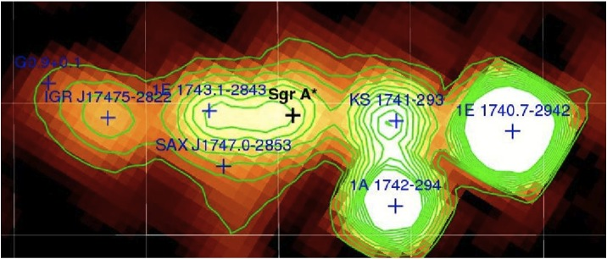
Galactic center simulation
Muno et al., 2009
Notes:
1E1740 is 12 mcrab in 5-80 kev (12cps). nustar depth will be about 6 uCrab (5-sigma) in 12 ksec per pix (1 ms total). at 8 kpc this is 2e33 ergs/sec

Slide 29
Populations
Survey the galactic center and Norma arm
Evolutionary phase:
CVs: Gyr lifetime
HMXBs: 10’s – 100’s Myr
More evolved regions have less HMXBs
High Mass X-ray Binary census
Indicators of star formation rate
Highly obscured sources discovered by Integral
Advanced LIGO progenitors
Notes:
Possibly survey scutum arm as well. CVs live for about a Gyr, HMXB upto about 100Myr

Slide 30
Sgr A*
Reflection nebulae:
Seen in Fe Kα in soft X-rays
Few hundred year old activity, 10³⁹ erg s⁻¹
Origin:
Light echo or flux variability?
SMBH or bright X-ray binary?
Sgr A* flares: one to few flares each week
Too faint for Integral
X-ray spectrum: Synchrotron? Inverse Compton? Thermal?
Flare source: Disc? Jet?

Slide 31
X-Ray Binaries
Science goals

Slide 32
INTEGRAL: Highly absorbed HMXBs
NuSTAR simulation: IGR J16318-4848 (20 ks observation)

Slide 33
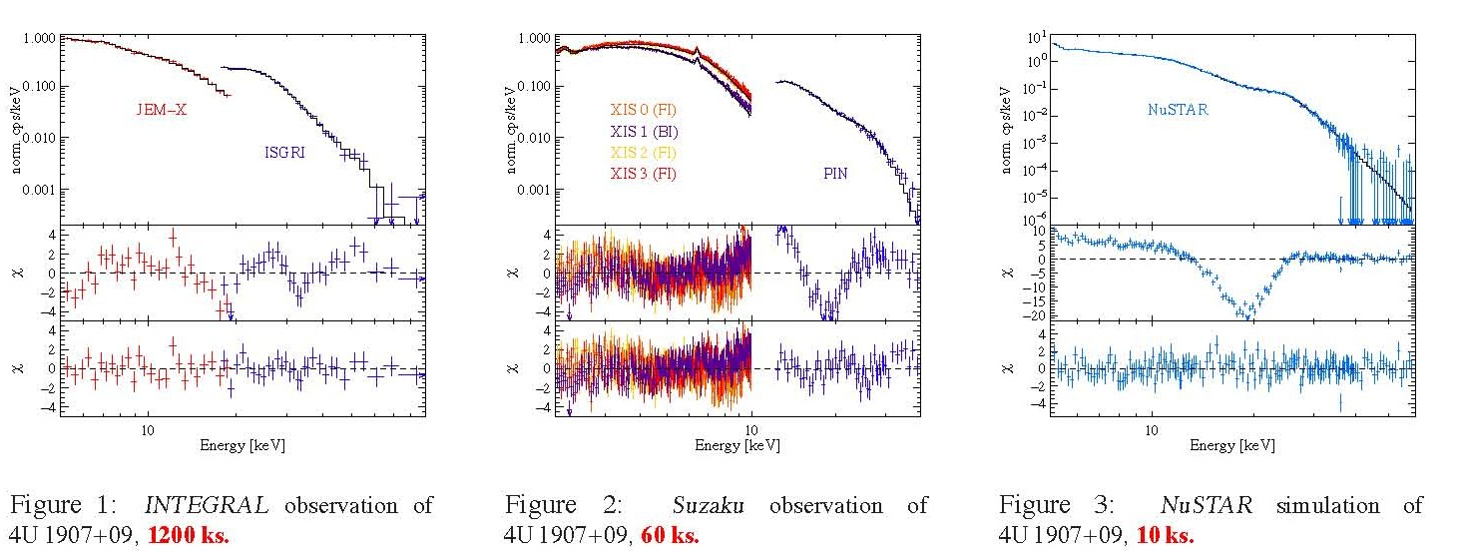
Cyclotron lines
Magnetic field strength
Structure of magnetosphere
Distortion by accretion flow
Notes:
John Tomsick, Katja Pottschmidt, Deepto Chakrabarty

Slide 34
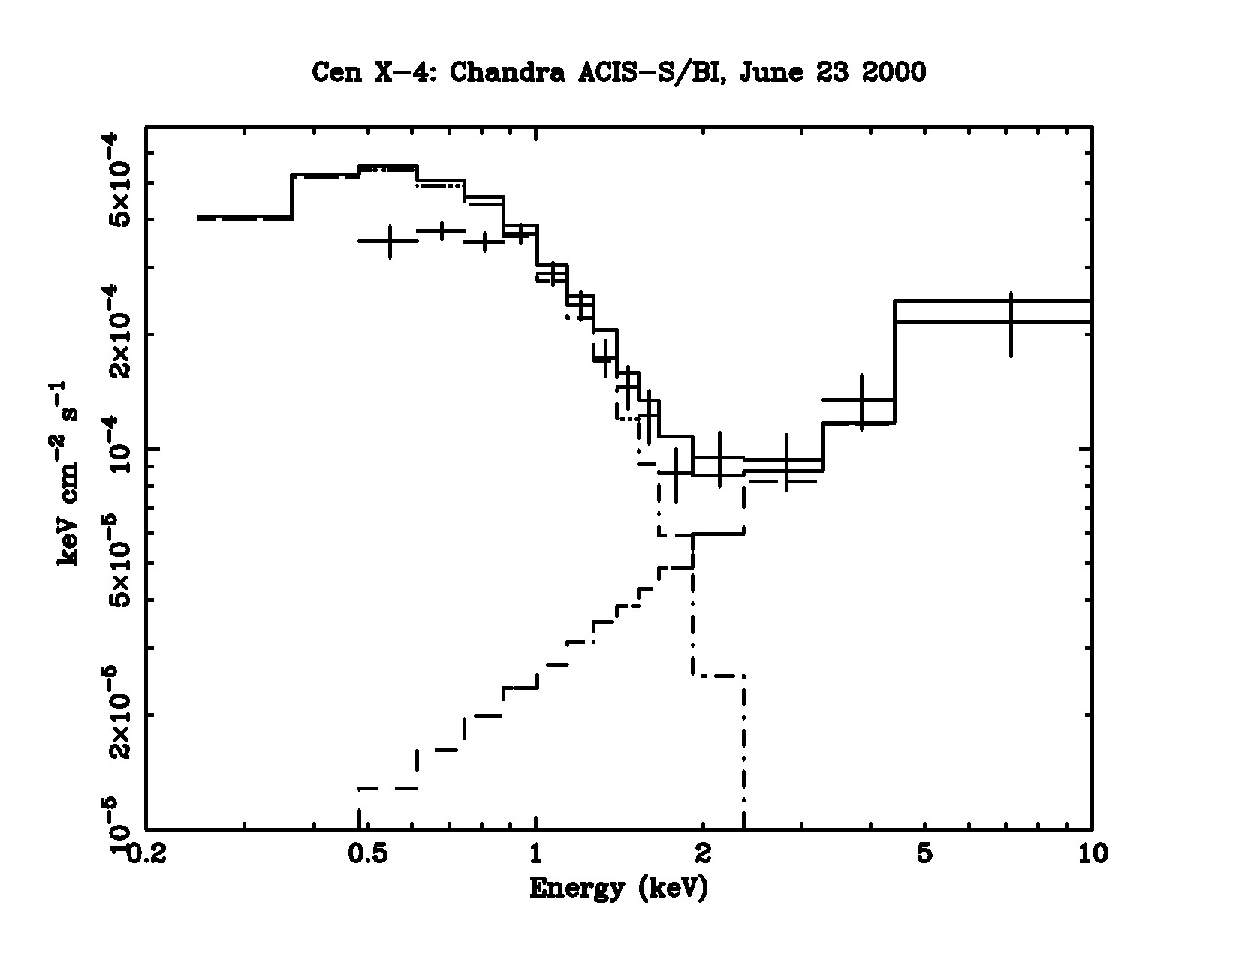
Low Mass X-Ray Binaries
NS: Quiescent emission
BH: low accretion rates
Cen X-4
(Chandra observations)
GX 339-4
(Nustar Simulation)

Slide 35
Absorption edges in Type-1 bursts
4U 0614+091
4U 1722-30
Photospheric expansion bursts: expose heavy metals
Photoionization edges of Fe, Co, Zn, and S could be detected by NuSTAR
Gravitational redshift
Notes:
In Hard state, bursts recur every few hours
Zn 12.2 keV, Fe 9.2 kev

Slide 36
Magnetars
Science goals

Slide 37
Magnetars at a glance
Young, isolated, ultra-magnetized neutron stars
Magnetic field, B = 10¹⁴ – 10¹⁵ G
Variability: sub second to years
Emission probably powered by decay of magnetic fields
Sub-classes:
Soft Gamma Repeaters: higher B, dramatic, frequent outbursts
Anomalous X-ray Pulsars: lower B, less active, occasional strong bursts
Notes:
The AXP – SGR classification may be superficial, there is evidence of such behaviour in much lower B objects

Slide 38
Spectra
Traditionally, very soft X-ray sources
Integral discovered hard component: making them one of the hardest X-ray sources.
Kuiper et al, 2006
Notes:
as another example, the latest magnetar Swift 1834.9-0846 was discovered by BAT as a GRB: GRB110807A. has mag field 1.4e14.

Slide 39
Models
3 source models
Corona near surface
Twisted magnetosphere
Electron – positron pairs
None match all data
Gavriil et al., 2010
Kaspi and Boydstun, 2006

Slide 40
NuSTAR contribution
Study correlated variability
Broad-band spectra to investigate if the soft and hard spectra vary the same way
Measure precise spectra
Detailed modeling, including spectral turnover
First ever hard X-ray phase resolved spectroscopy
Outburst observations
Characterize variation of hard spectrum
Infer source properties
Notes:
phase resolved: GR smears out signal if emission very close to surface

Slide 41
Ultra-Luminous X-ray Sources
Science goals

Slide 42
Ultra-Luminous X-ray Sources
Bright point sources in nearby galaxies
Variability on day – month timescales:
Accretion
Flux: 10³⁹ – 10⁴² erg s⁻¹
Exceeds L_{Edd} for stellar mass black holes
Could these be Intermediate Mass Black Holes ?
Notes:
NS Ledd = 2e38

Slide 43
ULX Central Engine
Intermediate Mass Black Hole:
Luminosity is sub-Eddington
Stellar Mass Black Hole:
Strongly non-spherical accretion, such as funnel shaped disk
Beamed emission from jet
Notes:
IMBH: mHz QPOs, but they cant be seen in jets. but then you should also see a few 10s to few 100s eV (NOT kev) soft continuum
h-alpha or photo-ionization if isotropic then it cannot be beamed emission

Slide 44
ULX emission mechanisms
Comptonization in corona
Cutoff in Hard X-rays, depending on electron temperature
Disc reflection
Power-law reflected by disc
Produces bump at 10-30 keV

Slide 45
NuSTAR contributions
Walton et al., 2011
Notes:
Spectrum = Thermal (1kev) + Fe Ka + power law (E^-gamma) + reflection from accretion disc
Fit components. Inner radius of acc disk is independent of the state => it is R_isco. gives mass + spin. QPO also gives the other part of the equation to disentangle mass and spin.
GRS1915+105, McClintock et al, 2006

Slide 46
ULX Quasi Periodic Oscillations
Two types of QPOs seen in galactic BH binaries.
Low frequency QPOs: < 30 Hz
Accretion in outer parts of disc
Fractional contribution highest in Hard X-rays
Nature of Hard X-ray emission
High frequency QPOs: 40 – 450 Hz
Frequency independent of spectral state of source
Keplerian frequency at Innermost Stable Circular Orbit
Black Hole mass and spin

Slide 47
NuSTAR simulations for QPOs
Detect QPOs
Amplitude – energy relations
Emission region and mechanism
M82 X-1 simulation by Rana et al. (NuSTAR internal memo)

Slide 48
Science
Galactic survey, SgrA*
Supernova Remnants / Planetary Wind Nebulae
Supernova Ia ToO
Magnetars
X-ray Binaries
Pulsars
Gamma-ray binaries
Flaring protostars
Sun
Extragalactic surveys
AGN physics
Ultra-Luminous Infra-Red Galaxies (ULIRGs)
Compton-thick AGN
Starburst galaxies
Galaxy clusters
Blazars
Radio galaxies
Ultra-Luminous X-ray Sources
Notes:
That was just a small glimpse into the science goals in the baseline mission. NuSTAR enables many other science goals by opening a new electromagnetic window. Here are is a list of some of the programs we will undertake in the two year baseline mission. I will be glad to discuss any of these offline.

Slide 49
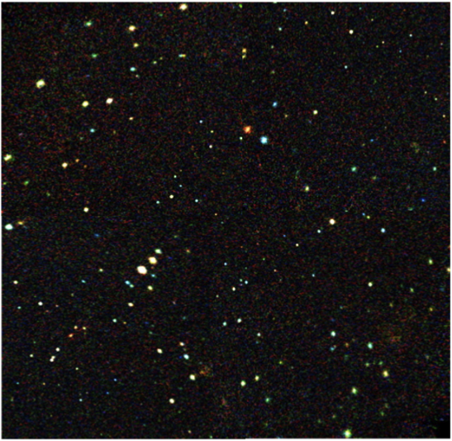
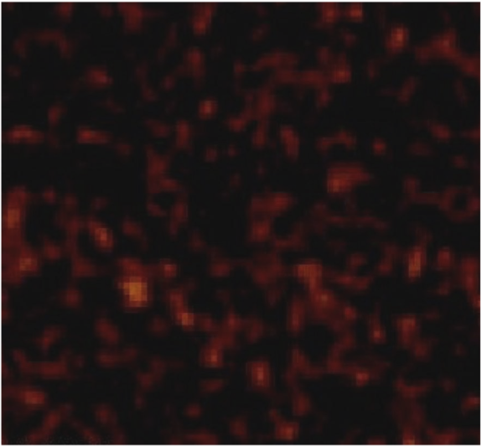
NuSTAR
Bringing the high energy universe in focus
Energy Range: | 6-79 keV
Angular Resolution: | 9” (FWHM) 50” (HPD)
Strong source position (>10-σ): | 1.5” (1-σ)
Field of View: | 10’ @ 10 keV 6’ @ 68 keV
Sensitivity (6-10 keV) (10-30 keV) | (3σ, 1 Ms) 2 x 10⁻¹⁵ erg/cm²/s 1 x 10⁻¹⁴ erg/cm²/s
Spectral Resolution: | 0.6 keV at 60 keV 0.4 keV at 6 keV
Timing Resolution: | 100 microseconds
ToO Response: | <24 hr
Launch Date: | February 2012
www.nustar.caltech.edu

Slide 50
The Nuclear Spectroscopic Telescope Array
NuSTAR
Varun Bhalerao on behalf of the NuSTAR team

Slide 51
Sources
Magnetic Cataclysmic Variables
Massive stars: single, binaries
High Mass X-ray Binaries
Neutron stars: Exponential cutoff at 10 – 15 keV
Black Holes: power law extending through 80 keV
Low Mass X-ray Binaries
Reflection nebulae
Seen in Fe Kα in soft X-rays
Diffuse emission from inverse Compton scattering from cosmic ray electrons
Notes:
massive stars: HMXBs, Colliding wind binaries, Isolated

